Slide 1
CSCIU 210 Computer Organization AKM Jahangir A Majumder, PhD
Fall 2018 - Lecture 6
September 7, 2018
Note: Some slides are adapted from those used by previous instructors and some slides include figures from the textbook.

Slide 2
Review and Learning Outcomes
We will continue to cover logic gates and expression today
Will discuss:
Boolean Equations
Logic Circuits
Number Systems
Key for HW 1 is posted on Blackboard
We will have our first Quiz today, which will be on Lectures 1, 2, 3 and 4

Slide 3
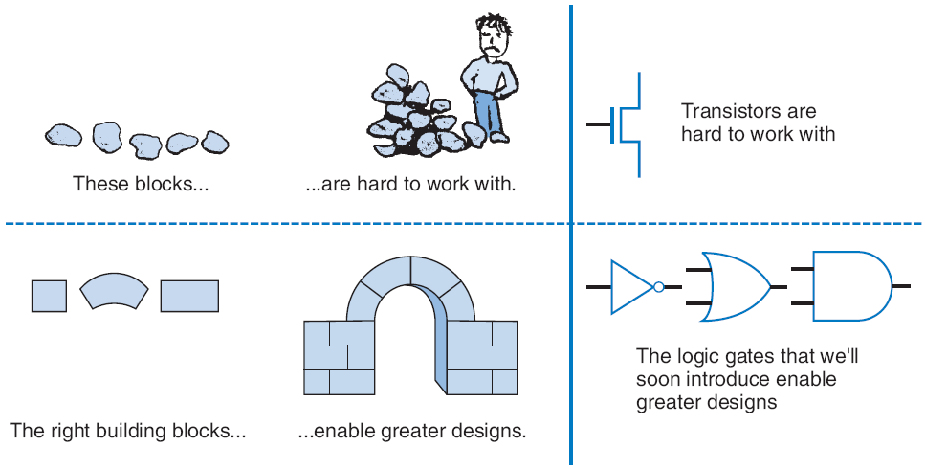
Boolean Logic Gates Building Blocks for Digital Circuits (Because Switches are Hard to Work With)
“Logic gates” are better digital circuit building blocks than switches (transistors)
Why?...

Slide 4
Boolean Algebra and its Relation to Digital Circuits
To understand the benefits of “logic gates” vs. switches, we should first understand Boolean algebra
“Traditional” algebra
Variables represent real numbers (x, y)
Operators operate on variables, return real numbers (2.5*x + y - 3)
Boolean Algebra
Variables represent 0 or 1 only
Operators return 0 or 1 only
Basic operators
AND: a AND b returns 1 only when both a=1 and b=1
OR: a OR b returns 1 if either (or both) a=1 or b=1
NOT: NOT a returns the opposite of a (1 if a=0, 0 if a=1)
a
b
AND
0
0
0
0
1
0
1
0
0
1
1
1
a
b
OR
a
0
0
0
0
1
1
1
0
1
1
1
1
a
NOT
0
1
1
0

Slide 5
Boolean Algebra and its Relation to Digital Circuits
Developed mid-1800’s by George Boole to formalize human thought
Ex: “I’ll go to lunch if Mary goes OR John goes, AND Sally does not go.”
Let F represent my going to lunch (1 means I go, 0 I don’t go)
Likewise, m for Mary going, j for John, and s for Sally
Then F = (m OR j) AND NOT(s)
Nice features
Formally evaluate
m=1, j=0, s=1 --> F = (1 OR 0) AND NOT(1) = 1 AND 0 = 0
Formally transform
F = (m and NOT(s)) OR (j and NOT(s))
Looks different, but same function
We’ll show transformation techniques soon
Formally prove
Prove that if Sally goes to lunch (s=1), then I don’t go (F=0)
F = (m OR j) AND NOT(1) = (m OR j) AND 0 = 0
a
b
AND
0
0
0
0
1
0
1
0
0
1
1
1
a
b
OR
0
0
0
0
1
1
1
0
1
1
1
1
a
NOT
0
1
1
0

Slide 6
Evaluating Boolean Equations
a
Evaluate the Boolean equation F = (a AND b) OR (c AND d) for the given values of variables a, b, c, and d:
Q1: a=1, b=1, c=1, d=0.
Answer: F = (1 AND 1) OR (1 AND 0) = 1 OR 0 = 1.
Q2: a=0, b=1, c=0, d=1.
Answer: F = (0 AND 1) OR (0 AND 1) = 0 OR 0 = 0.
Q3: a=1, b=1, c=1, d=1.
Answer: F = (1 AND 1) OR (1 AND 1) = 1 OR 1 = 1.
a
b
AND
0
0
0
0
1
0
1
0
0
1
1
1
a
b
OR
0
0
0
0
1
1
1
0
1
1
1
1
a
NOT
0
1
1
0

Slide 7
Converting to Boolean Equations
a
Convert the following English statements to a Boolean equation
Q1. a is 1 and b is 1.
Answer: F = a AND b
Q2. either of a or b is 1.
Answer: F = a OR b
Q3. a is 1 and b is 0.
Answer: F = a AND NOT(b)
Q4. a is not 0.
Answer:
(a) Option 1: F = NOT(NOT(a))
(b) Option 2: F = a

Slide 8
Converting to Boolean Equations
Q1. A fire sprinkler system should spray water if high heat is sensed and the system is set to enabled.
Answer: Let Boolean variable h represent “high heat is sensed,” e represent “enabled,” and F represent “spraying water.” Then an equation is: F = h AND e.
Q2. A car alarm should sound if the alarm is enabled, and either the car is shaken or the door is opened.
Answer: Let a represent “alarm is enabled,” s represent “car is shaken,” d represent “door is opened,” and F represent “alarm sounds.” Then an equation is: F = a AND (s OR d).
(a) Alternatively, assuming that our door sensor d represents “door is closed” instead of open (meaning d=1 when the door is closed, 0 when open), we obtain the following equation: F = a AND (s OR NOT(d)).
a

Slide 9
Boolean Equations - Examples
1
A+A’
(A+B)⋅1
(A⋅0)+(B⋅0)
A+B+C+D
A⋅1+B⋅1

Slide 10
Laws of Boolean Algebra (I)
Identity law
A + 0 = A
A⋅1 = A
Zero and One laws
A + 1 = 1
A ⋅0 = 0
Inverse laws
A + A’ = 1
A⋅ A’ = 0

Slide 11
Laws of Boolean Algebra (II)
Commutative laws
A + B = B + A
A . B = B . A
Associative laws
A + (B + C) = (A + B) + C
(A . B) . C = A . (B . C)
Distributive laws
A. (B + C) = (A.B) + (A.C)
A+(B . C) = (A+B) . (A+C)

Slide 12
Boolean Algebra Operator Precedence
High to low
() – Inner most parentheses first
NOT (’)
AND ( •)
OR (+)

Slide 13
From Boolean Equations to Logic Circuits
Straightforward process
Each operator becomes a Gate
Suitably connect outputs to inputs
Pay attention to crossing lines versus connected lines
Label all inputs and outputs of each gate

Slide 14
Example
A.B.C.D
(A.B).(C.D)
A
A⋅B
B
A⋅B⋅C⋅D
C
D
C⋅D

